Slide 1
Digital Portfolio
STUDENT NAME: EPSIBA B
REGISTER NO AND NMID: 212400997/
DC4524BE32464A7B2F8482476E9C803B
DEPARTMENT: COMPUTER APPLICATION
COLLEGE: UNIVERSITY OF MADRAS

Slide 2
PROJECT TITLE
DIGITAL PORTFOLIO

Slide 3


AGENDA
Problem Statement
Project Overview
End Users
Tools and Technologies
Portfolio design and Layout
Features and Functionality
Results and Screenshots
Conclusion
Github Link
3/21/2024 Annual Review

Slide 4

PROBLEM STATEMENT
Many professionals struggle to present their work effectively online. Traditional resumes lack visual appeal and interactive elements. Social media platforms are limited in showcasing detailed projects. There’s a need for a customizable, user-friendly digital portfolio.It should reflect skills, personality, and allow easy content updates.

Slide 5

PROJECT OVERVIEW
This digital portfolio is a personal website built to present my background, skills, and work in a professional format. It features an “About Me” section to share who I am, a “Skills” section that highlights my technical strengths, a “Projects” section showcasing selected work, and a “Contact” section for easy communication. The goal is to create a simple, modern platform that reflects my personality and helps connect with potential clients, employers, or collaborators.

Slide 6

WHO ARE THE END USERS?
Potential Employers – Hiring managers or recruiters reviewing your skills, experience, and projects.
Clients – Individuals or businesses looking to hire you for freelance or contract work.
Collaborators or Team Members – People interested in working with you on professional or creative projects.
Academic Institutions – For applications to universities, internships, or scholarships.
General Viewers – Anyone interested in your work, including peers, mentors, or industry professionals.

Slide 7

TOOLS AND TECHNIQUES
Tools Used:
HTML – To structure the content of the digital portfolio.
CSS – To style and layout the web pages for a clean and responsive design.
Online HTML Compiler / Code Editor – Used to write, test, and run the code (e.g., VS Code, CodePen, JSFiddle).
Browser Developer Tools – For debugging and previewing the layout across different screen sizes.
Techniques Applied:
Semantic HTML – For meaningful, well-structured content that’s easier to maintain and accessible.
Responsive Design – Ensured that the portfolio looks good on mobile, tablet, and desktop devices.
Clean Code Practices – Used proper indentation and comments for better readability and maintenance.
Basic Layout Techniques – Used CSS Flexbox or Grid for organizing sections like About, Skills, Projects, and Contact.

Slide 8
POTFOLIO DESIGN AND LAYOUT
The portfolio features a simple and intuitive layout that highlights my work and skills clearly. Each section—About Me, Skills, Projects, and Contact—is organized in a vertical flow, making it easy for visitors to scroll and find information. The use of clean typography and a balanced color scheme creates a professional and inviting look. The navigation menu allows quick access to all sections without clutter. The design is fully responsive, ensuring a smooth experience on desktops, tablets, and smartphones.
8

Slide 9
FEATURES AND FUNCTIONALITY
About Me Section: Provides a brief introduction
Skills Section: Displays my soft skils
Projects Section: Showcases selected projects with descriptions, images, and links to live demos or repositories.
Contact Section: Includes a form or contact details for easy communication.
Responsive Design: Ensures the portfolio looks great and works well on all devices.

Slide 10
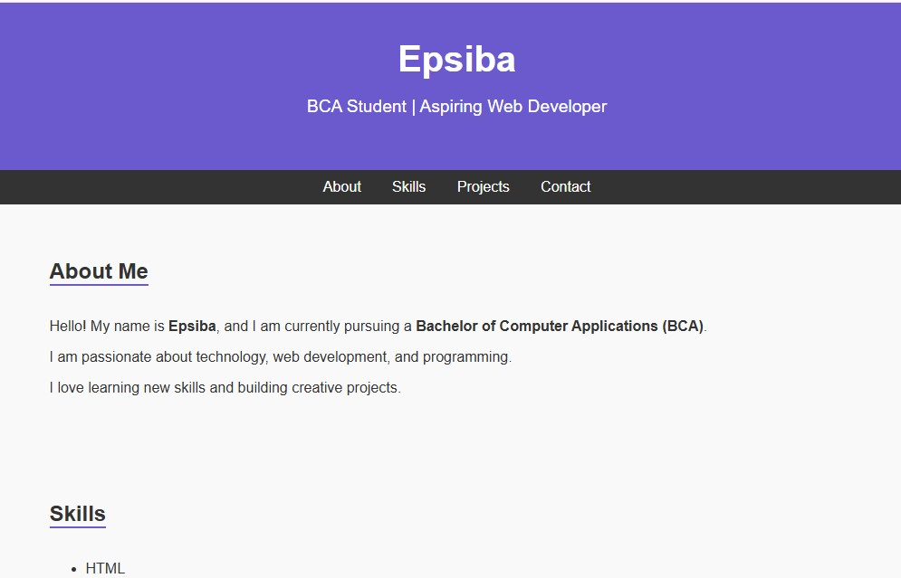

RESULTS AND SCREENSHOTS
3/21/2024 Annual Review
10

Slide 11
CONCLUSION
This digital portfolio effectively showcases my skills, projects, and professional background in a clear and engaging way. It serves as a personal brand platform that connects me with potential employers, clients, and collaborators. The design focuses on simplicity, responsiveness, and ease of use to ensure a positive user experience across all devices. Overall, this portfolio is a valuable tool for presenting my work and growing my career.
11

